Slide 1
Advanced OOP Tech Using C#/.NET
Ryan Darras

Slide 2
Intro
Ryan Darras
MS CS, estimated matriculation – May 2019
rdarras@uccs.edu
Office Hours
Monday – 4:20-5:20, same time every other Wednesday
(It is likely that 109 will be occupied during that time, might need to find alternative)
Resources
Everything will be available via Canvas

Slide 3
Outline
Why take this course?
What topics will be covered?
Homework/Tools
Project/Exams
Policy

Slide 4
Why take this course?
Be able to code more efficiently.
Learn to understand more advanced concepts.
Evolve your coding standards.
Learn a new language.

Slide 5
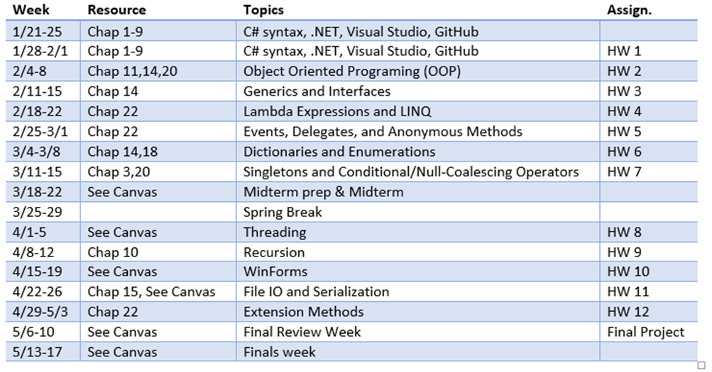
What topics will be covered?

Slide 6
Homework/Tools
GitHub
All work will be done on your own repositories that I have access to.
SourceTree/GitWindows/Terminal
Interfacing with GitHub
12 Programming Assignments
Every assignment will be due before class on Monday the following week.
On Canvas, submit a response letting me know your assignment is done and ready on GitHub.

Slide 7
Project/Exams
Final project
You decide what you want to develop.
Game, Tool, Simulation, etc.
~10-30 hours development time.
Exams
Midterm & Final
Most likely going to be practical exam. IE – “Here is a problem, you have an hour to solve it”
Open internet, open book, open google, etc. Just not open classmate.

Slide 8
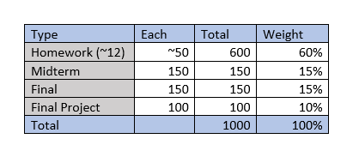
Policy
Grading

Slide 9
Policy
Late work
No late work will be accepted barring extenuating circumstances.
If something comes up to where you won’t be able to get an assignment turned in on time, you must notify me as soon as possible. Case-by-case basis.
Grading
I’m giving myself 1 week for every assignment to have scores graded and feedback given.
Help
Any questions/comments/concerns should be directed to the discussion forum on Canvas.
It is likely that another student may be able to answer your question faster than I can get to it.
It is likely that another student may benefit from your question/answers.
Use your best judgement. If you think your question/comment/concern should be sent directly to the instructor, do so.
IE don’t paste your entire project’s code into the discussion form.

Slide 10
Policy
Class Time
Lecture/Practica/Group Work/Etc
Attendance
I’m not taking attendance. This is a 3000 level course that you are paying a lot of money for. I expect you to take full advantage of class time.
If you cannot make it to class, it is your responsibility to make up the missed materials.
Note: Every other week I might be 5-10 minutes late to class depending on traffic. I will have material available on Canvas that you can start working on.

Slide 11
HW 1
Due Feb 4th, 3:05 pm
TODO:
Install Visual Studio 2017 Community
Set up GitHub account (I recommend using personal email, not UCCS email)
Set up SourceTree/GitWindows/Terminal
Develop C# program
A collection of tasks similar to what you have developed in 1150 and 1450.
These tasks should be easy to complete, and are assigned to give you practice with the C# language.
I’ve included an executable file in the assignment description that you can use to guide your development.

